Slide 1
Data Structures
Prof. Dhananjay S. Deshpande
SICSR, Pune-16.

Slide 2

What we have to consider before we will start to study?
What is the Computer Science?
Why we need to study data structures?
A place of data structures within the Computer Science.

Slide 3
Computer Science and
Data Structures
Organization of data processing and methods of data processing are a subject of Computer Science.
A Data Structure is a collection of data organized in some logical pre-defined way.
Studying Computer Science you will study different methods of data processing.
Where is the initial point of this branch of science?

Slide 4

Historical Overview
“Zero Generation”: Mechanical Computers (1642-1945)
Blez Pascal (1623-1662), 1642, the first mechanical computer for addition and subtraction

Slide 5
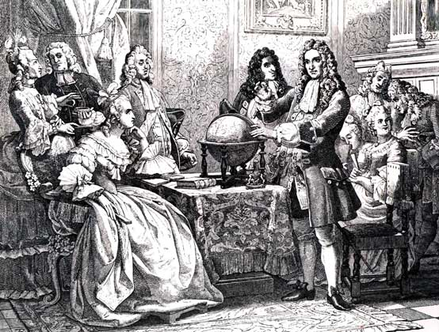
Historical Overview
“Zero Generation”: Mechanical Computers (1642-1945)
Gottfried Wilhelm von Leibniz (1646-1716), 1672, the first mechanical computer for addition, subtraction, multiplication and division

Slide 6
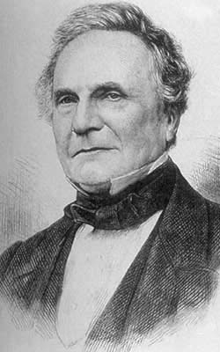
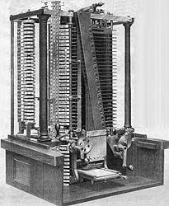
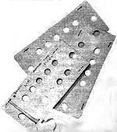
Historical Overview
“Zero Generation”: Mechanical Computers (1642-1945)
Charls Babbige (1792-1871), 1834
Henry Babbige, 1888
“The Analytical Machine” – the first programmable computer

Slide 7
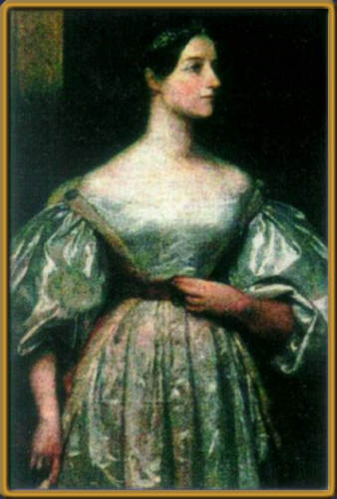
Historical Overview
“Zero Generation”: Mechanical Computers (1642-1945)
Ada Augusta Lovelase (1815-1852), 1843
The first programmer in the world, developed the first programming language in the world and the first software for the Babbige’s computer

Slide 8
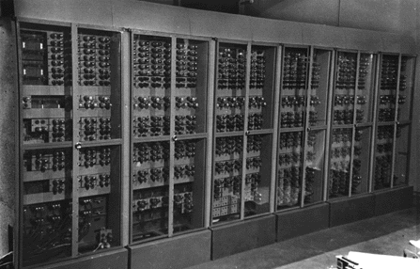
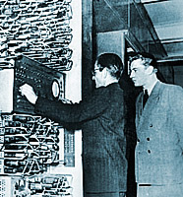
Historical Overview
The 1st generation electronic computers (1945-1953)
Input and Control Device
512 Bytes Memory

Slide 9
Cybernetics
Cybernetics is the study of communication and control, typically involving regulatory feedback, in living organisms, in machines and organisations and their combinations, for example, in sociotechnical systems, computer controlled machines such as automata and robots.

Slide 10
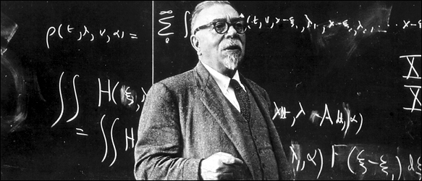
Cybernetics
Norbert Wiener (1894-1964) is a founder of Cybernetics (1948).
He coined the term "cybernetics" in his book “Cybernetics or Control and Communication in the Animal and the Machine” (MIT Press, 1948), widely recognized as one of the most important books of contemporary scientific thinking.

Slide 11
Data processing
Control and feedback in any computer controlled system (including a computer itself) are reduced to analysis and transmission of different data.
To analyze the corresponding data, those methods that can be presented in mathematical and logical description are used.
Organization of data processing and methods of data processing are a subject of Computer Science.

Slide 12
Algorithm
An algorithm is a finite set of well-defined instructions for accomplishing some task which, given an initial state, will terminate in a defined end-state.
To develop any algorithm, it is necessary to know, how the corresponding task can be solved.

Slide 13
Types of Algorithms
Linear algorithm consists of a sequence of unconditional straightforward steps.
Loop is a group of steps that are repeated until some condition will not be satisfied.
Nested Loop is a loop containing another loop (loops).
Branching algorithm consists of a number of subsequences that can be taken depending on some condition (conditions).

Slide 14
Algorithm
In Computer Science and Engineering flowcharts are often used to graphically represent algorithms.

Slide 15
Algorithms and Programming Languages
To utilize any algorithm using a computer, we have to develop a program using a programming language.
Low-level language (assembly language) is a language of machine instructions.
High-level language is a language, which is closer to our natural language.
A program is implementation of the algorithm in a form acceptable for a computer.

Slide 16
Data Structures
Any computer program serves some kind of data processing.
Even those programs that do not compute anything (for instance, a program that copying a file from one location to another one) operate with some data.
To access these data and to collect the resulting data, it is necessary to organize them in some reasonable structures.

Slide 17
Data Structures
The simplest data structures are: a simple variable and a constant.
Other data structures are: arrays, records, lists, trees, stacks, queues, etc..
Data structures are organized similarly in all the programming languages.
The latter means that data structures can be studied independently of a particular programming language.
Knowing data structures, it is easier to learn different programming languages.

Slide 18
Any Questions???

